Slide 1

AI Agents
A Presentation by
Soumadip Dey
Assistant Professor, Dept. of Computational Sciences
Prepared for Course MCA17405(T) in ODD Semester 2025-2026 Academic Year

Slide 2
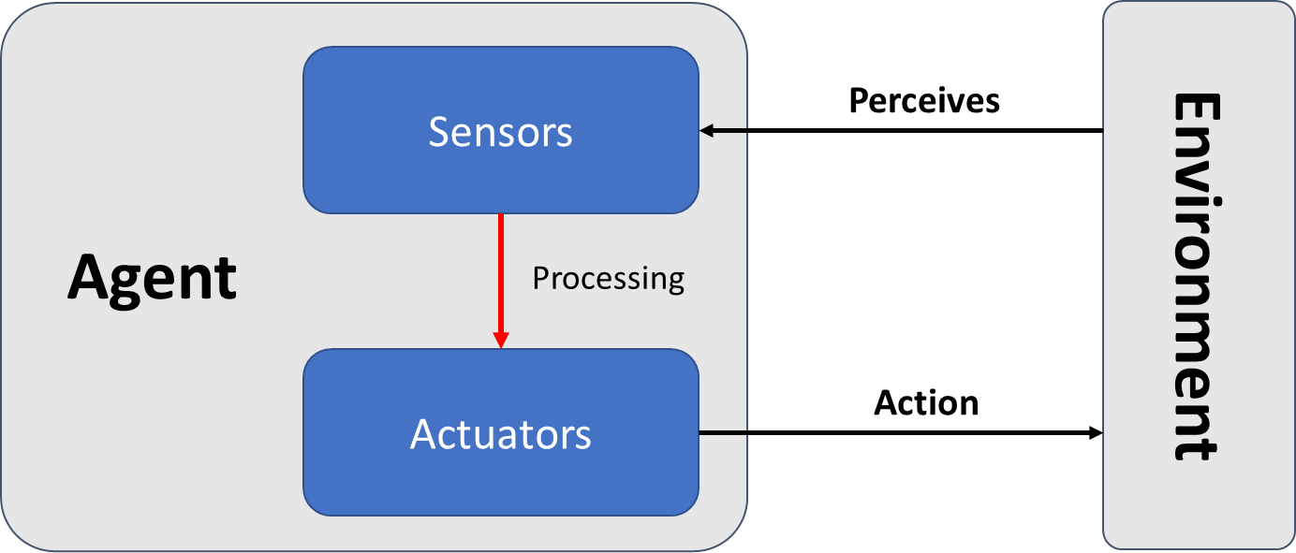
Agent-Environment Interaction
An agent perceives the environment through sensors.
It processes the input and decides an action.
Actuators then act on the environment.
This perception–processing–action loop forms the basis of intelligent behavior. The upcoming slides discuss the common types of intelligent agents.

Slide 3
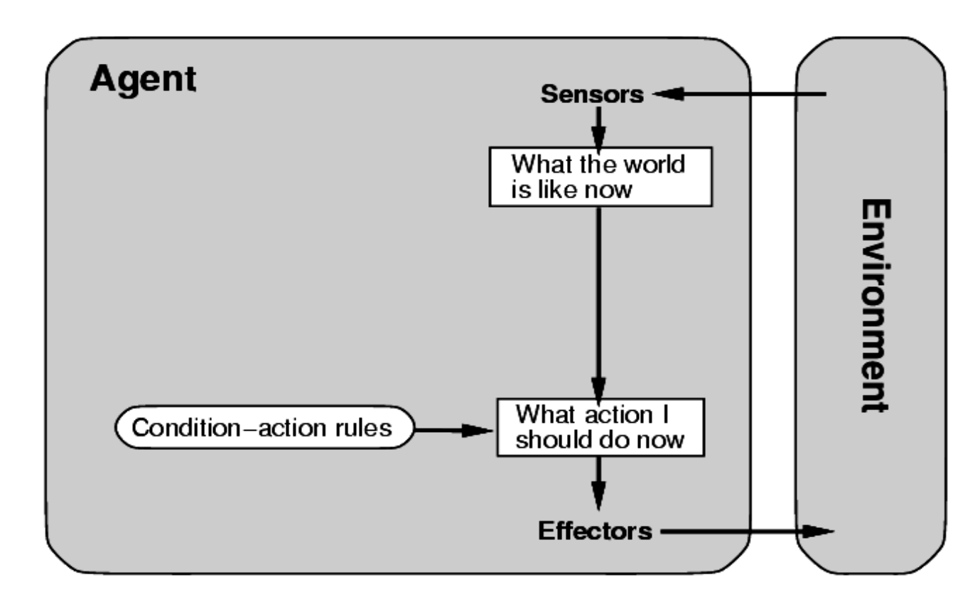
Simple Reflex Agent
React only to the current percept
Use condition-action rules
No memory or internal state:
📌 Example: Automatic room light system

Slide 4
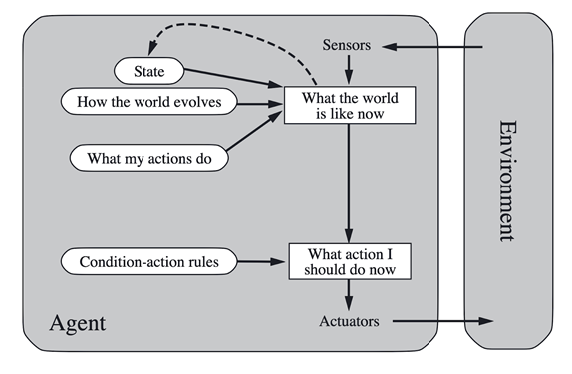
Model-Based Reflex Agents
Maintain an internal model of the world
Can handle partially observable environments
Use history and rules for decision-making
📌 Example: Vacuum cleaner robot that maps dirty areas

Slide 5
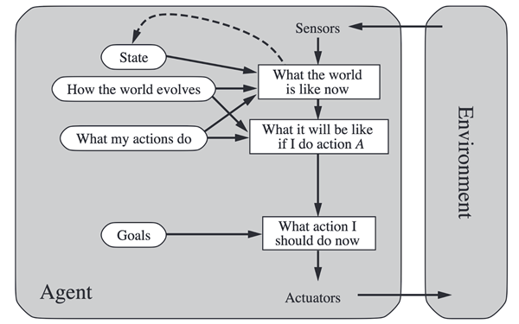
Goal Based Agent
Act to achieve a specific goal
Employ search and planning algorithms
Evaluate possible future states
📌 Example: Chess-playing agent that plans several moves ahead, Maze Solver Agent

Slide 6
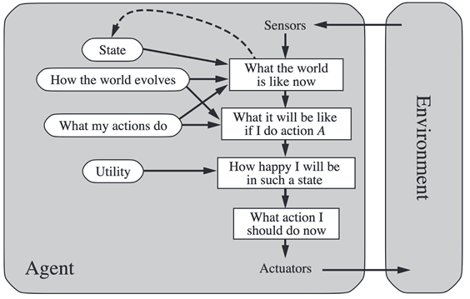
Utility Based Agent
Choose actions based on a utility function
Aim for the most beneficial outcome
Resolve trade-offs and preferences
📌 Example: Self-driving car optimizing safety, time, and comfort, Shortest Path Finding

Slide 7
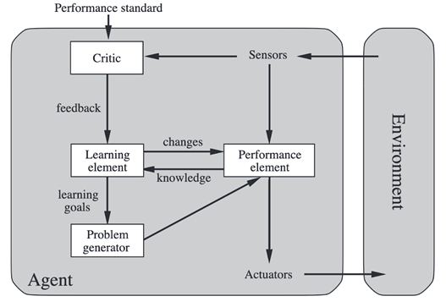
Learning Agent
Improve performance over time
Learn from experience and feedback
Components:
Learning element, Performance element, Critic, Problem generator
📌 Example: Personal AI assistant (e.g., Siri, Alexa), Content Recommendation algorithms.

Slide 8
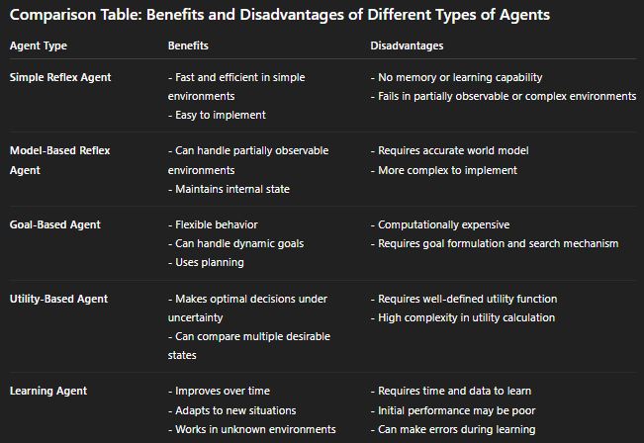

Slide 9
Mapping Agents to Environments
Agent Type | Ideal Environment
Simple Reflex Agent | Fully observable, static, deterministic
Model-Based Agent | Partially observable, sequential
Goal-Based Agent | Sequential, deterministic, or partially observable
Utility-Based Agent | Stochastic or conflicting-goal scenarios
Learning Agent | Complex, dynamic, non-deterministic environments

Slide 10
Real-World Examples
Scenario | Agent Type | Environment Type
Smart Thermostat | Simple Reflex Agent | Fully observable, static, deterministic
Self-Driving Car | Utility-Based Agent | Partially observable, dynamic, continuous
AI Personal Assistant | Learning Agent | Partially observable, dynamic, stochastic
Industrial Robot Arm | Goal-Based Agent | Fully observable, deterministic
Multiplayer Strategy Game | Learning / Goal-Based | Multi-agent, sequential, stochastic

